Slide 1
Kubernetes Hands On
Part 1

Slide 2
Github Repository
Please clone the repository for all the files, commands and instructions
https://github.com/keshavprasadms/kubernetes-training

Slide 3
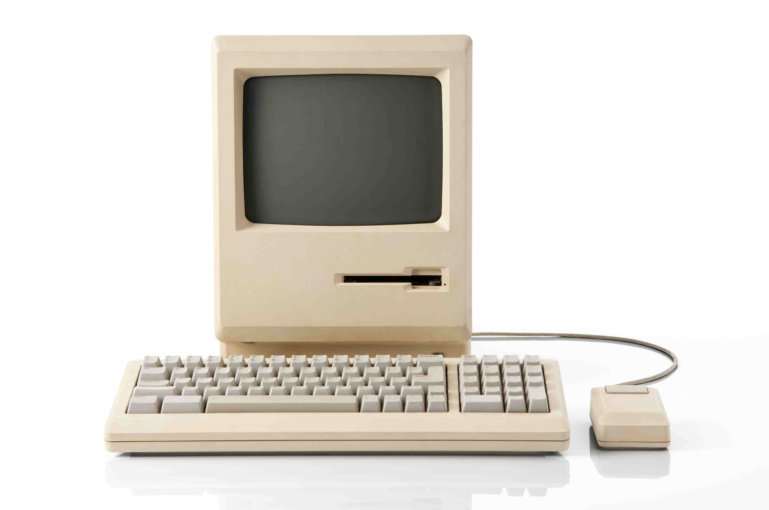
Physical Machine
A physical server, also known as a ‘bare-metal server,’ is a single-tenant computer server, meaning that a specific physical server is designated to a single user
The resources and components of a physical server are not shared between multiple users. Each physical server includes memory, processor, network connection, hard drive, and an operating system (OS) for running programs and applications
Notes:
Users on a system - Isolation
Multiple vagrants
Demo on installing and running a software

Slide 4
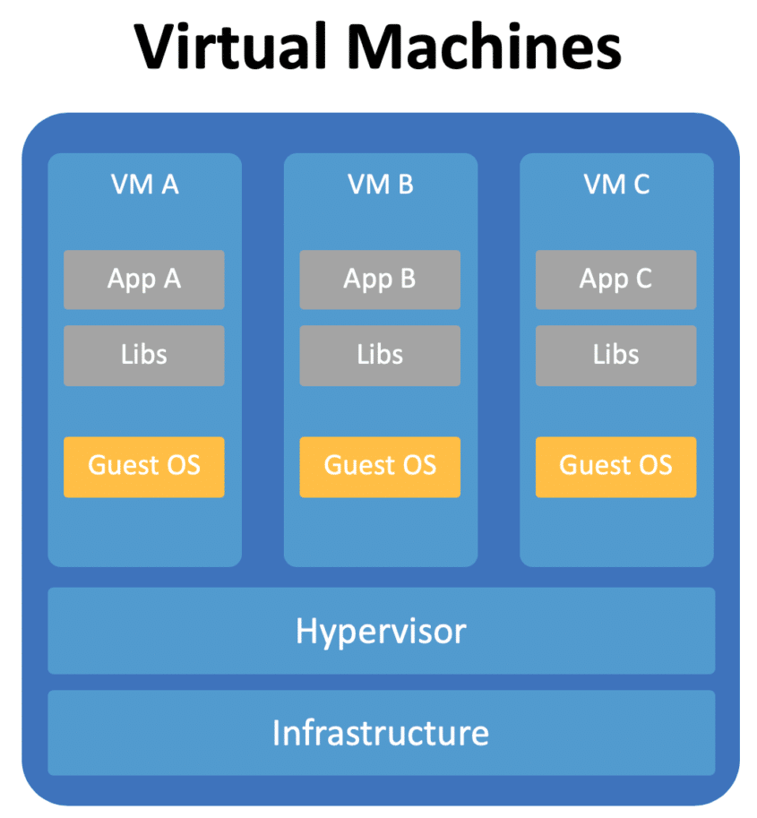
Virtual Machine
Virtualisation is the process of creating a software-based or "virtual" version of a computer, with dedicated amounts of CPU, memory and storage that are "borrowed" from a physical host computer—such as your personal computer— and/or a remote server—such as a server in a cloud provider's data centre
A virtual machine is a computer file, typically called an image, which behaves like an actual computer. It can run in a window as a separate computing environment, often to run a different operating system—or even to function as the user's entire computer experience
The virtual machine is partitioned from the rest of the system, meaning that the software inside a VM cannot interfere with the host computer's primary operating system
Notes:
Demo on VirtualBox and Vagrant and the OS images

Slide 5
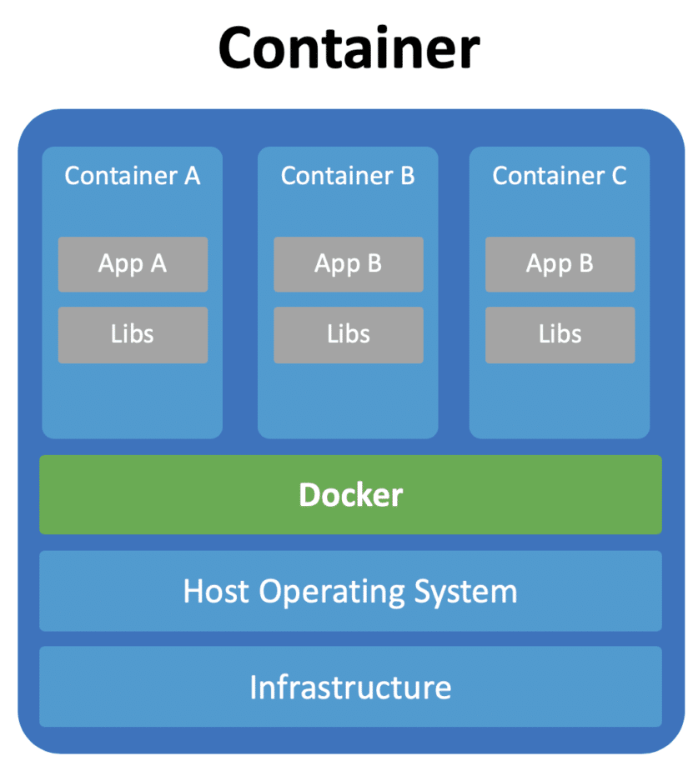
Docker
Docker is an open platform for developing, shipping, and running applications. Docker enables you to separate your applications from your infrastructure
Docker provides the ability to package and run an application in a loosely isolated environment called a container. The isolation and security allows you to run many containers simultaneously on a given host
Containers are lightweight and contain everything needed to run the application, so you do not need to rely on what is currently installed on the host. You can easily share containers and be sure that everyone you share with gets the same container that works in the same way
Notes:
Demo on docker and images

Slide 6
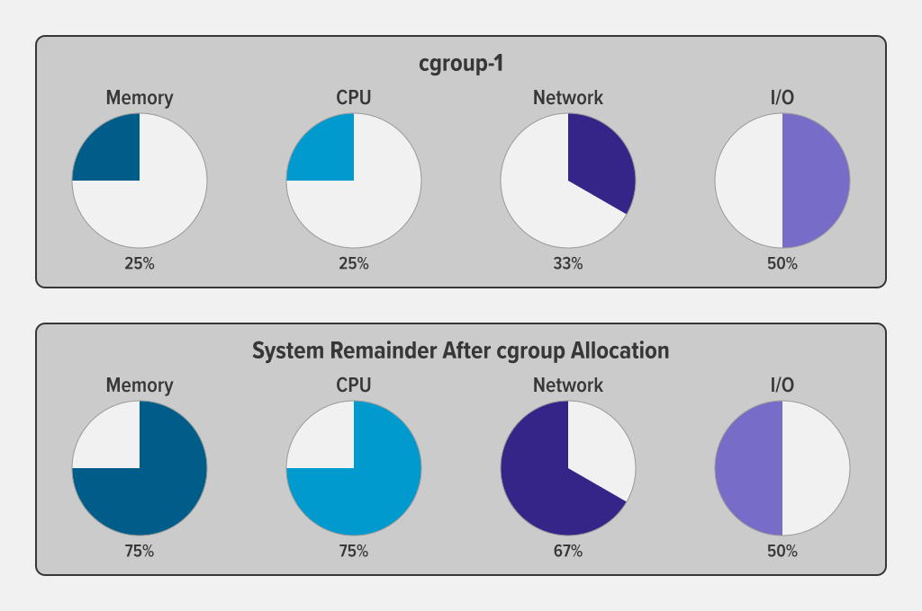
Linux Cgroups

Slide 7
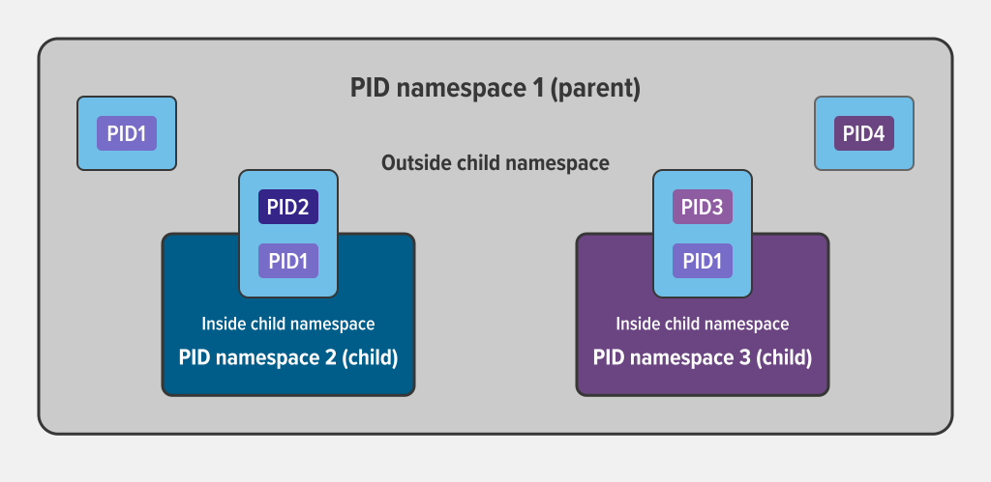
Linux Namespaces

Slide 8
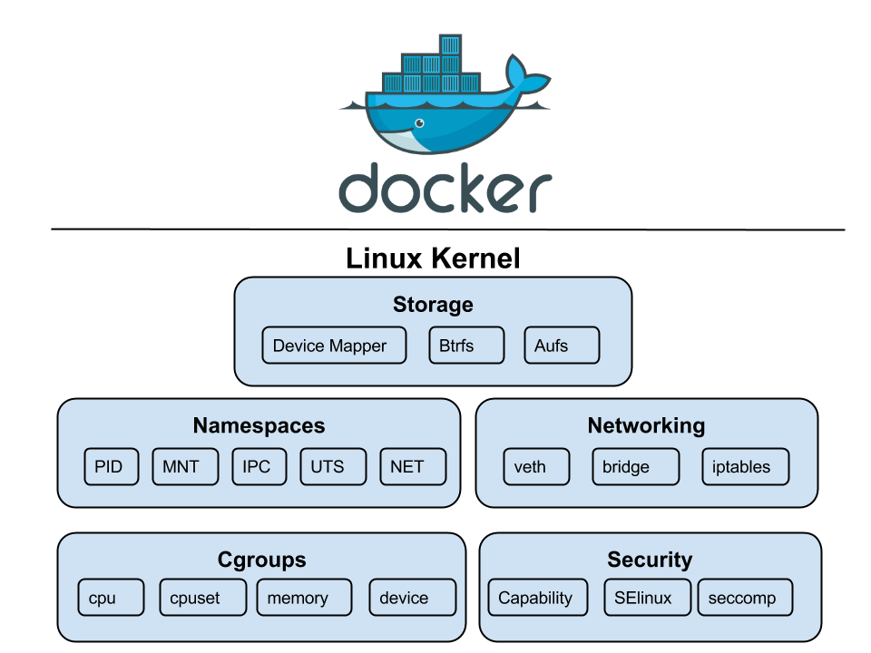
Docker Isolation

Slide 9
Hands On
Vagrant and VirtualBox
Linux Cgroups and Namespaces
Installing Docker
Building and Pushing Docker Images
Running and Accessing Docker Containers
Viewing Docker Containers Information
Checking Docker Logs
Login to the containers
Copying Data to / from Containers
Stop / Restart / Kill Containers
Inter Container Communication
Restricting Resources and Metrics
Sharing namespaces (pid)
Persisting Container Data
Environment Variables and Files
Notes:
Need a docker hub account

Slide 10
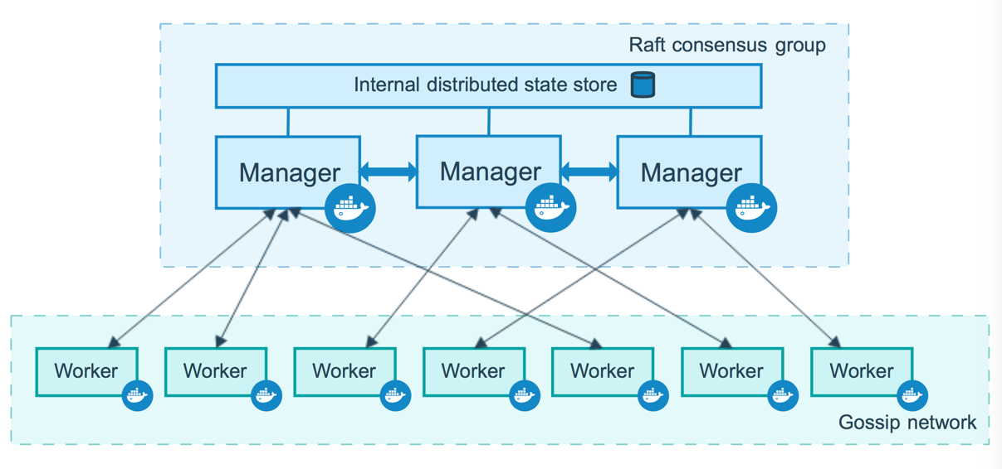
Docker Swarm

Slide 11
Hands On
Creating Docker Swarm
Running and Accessing Swarm Services
Viewing Docker Service Information
Inspecting Docker Service Logs
Scaling Docker Services
Inter Service Communication
Persisting Docker Service Data
Restricting Resources and Metrics for Docker Services
Rollback Service
Docker Config, Environment Variables and Files
Docker Compose File
Docker Stack File

Slide 12
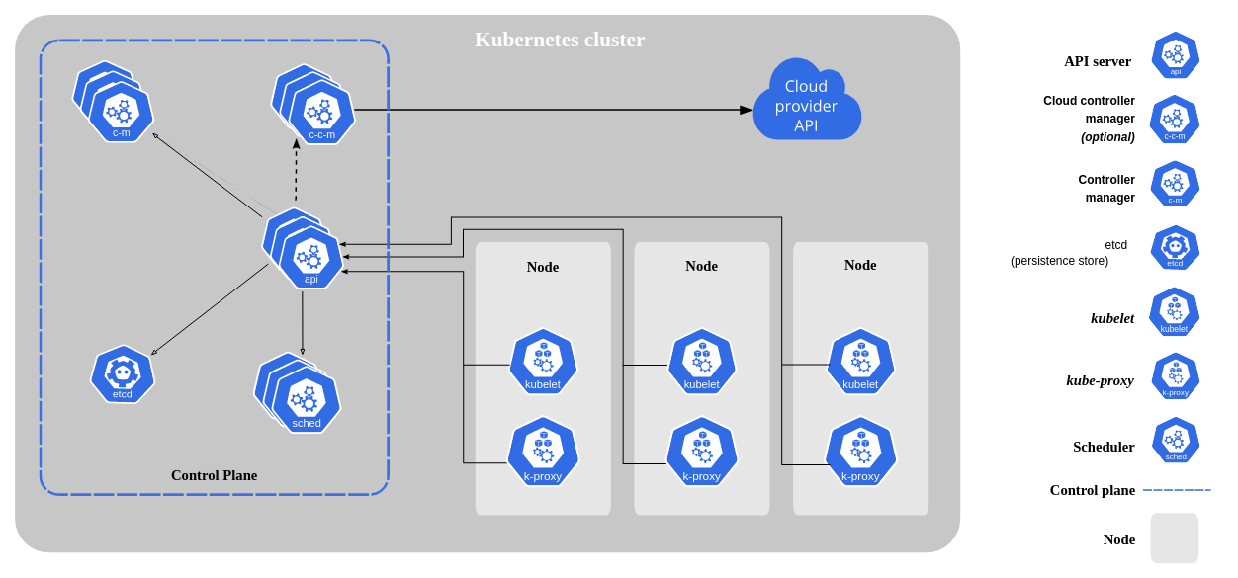
Kubernetes
Kubernetes, also known as K8s, is an open-source system for automating deployment, scaling, and management of containerized applications

Slide 13
Hands On
Installing Kubernetes
Running Kubernetes Pods
Viewing Pod Information
Exposing Pod and Accessing the Applications
Inspecting Pod Logs
Login to the Pods
Stop / Restart / Kill Pods
Running Pods with Replicas
Inter Pod Communication
Restricting Resources and Metrics
Namespaces
Environment Variables and Configmaps
Manifest File

Slide 14
Docker Swarm vs Kubernetes
Swarm
Lightweight and easy to understand
No Autoscaling
No cloud provider integrations
Limited Access Control
Lower Cost
Has load balancing out of the box
Kubernetes
Complex and difficult to understanding
Autoscaling
Cloud provider integrations
Advanced Access Control
Higher Cost
Need additional setup for load balancing

Slide 15
Containerd and Podman
Containerd
An alternative to docker engine
Uses crictl as the command line tool
Containerd Hands On
Installing containerd and crictl
Running containers on containerd
Accessing containers / pods using crictl
Podman
Pod man is an alternative to docker cli
Exactly like the docker command
Podman Hands On
Building container images using podman
Running containers using podman
Accessing containers using podman

